Slide 1
A Data-Based Approach to Playlist-Making
Tommy DeBenedetti
Notes:
Hi my name is tommy
Im gonna be presenting on my project exploring a data-based ….
This project is inspired by …

Slide 2


Here’s my current playlist creation strategy
chill 😜🤘
chill 😌🧘‍♂️
Notes:
This dichotomy.
These = 2 my real playlists
On the left, chill — like this is really chill really cool
On the right, chill — this is very calm and mellow really chill
This makes perfect sense in my mind although its ambiguous
So …

Slide 3

Data Collection
Notes:
I thought i’d get a little more empirical with my playlist making
To do so I went to spotify’s own api
I took all of the songs from my “liked songs” and i collected both sets of data spotify shares

Slide 4
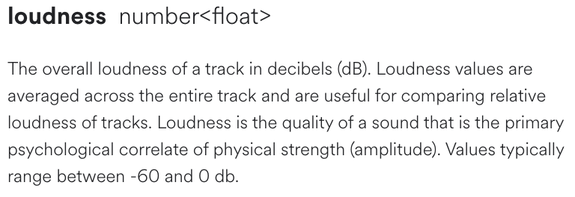
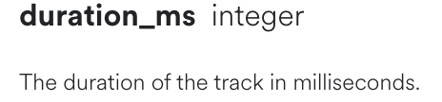
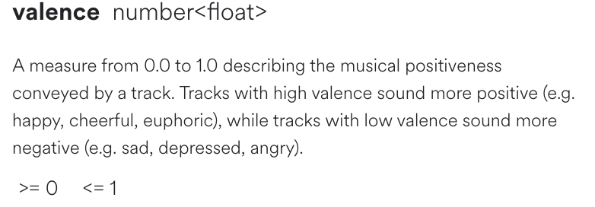
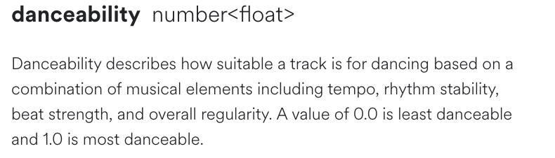
Audio Features
Notes:
The first is called audio features - more surface level
Some objective — the loudness, duration
Others seemingly more subjective — danceability, valence
The second data set spotify provides is

Slide 5
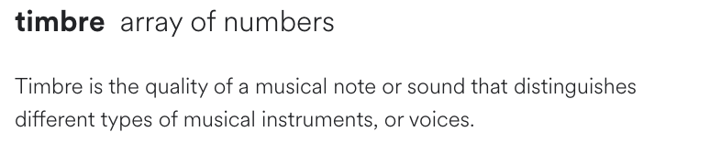
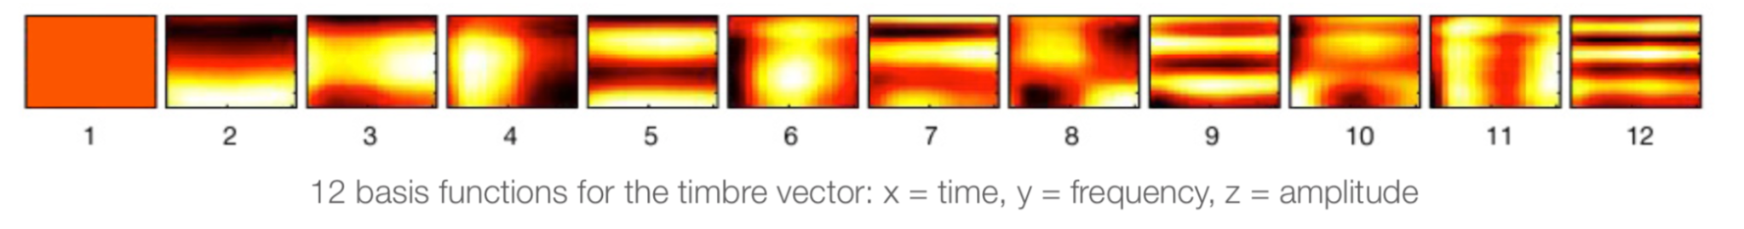
Audio Analysis
Notes:
Audio analysis, which is much more technical
Im interested in …
Timbre frequency vector (something that seems abstract they have quantified it as a vector)
Vectorization!!
I joined this dataframe to the features one on the “spotify id” of each track, which uniquely identifies it

Slide 6
Data Exploration
Notes:
Now that all of the data is in one place, let’s explore

Slide 7
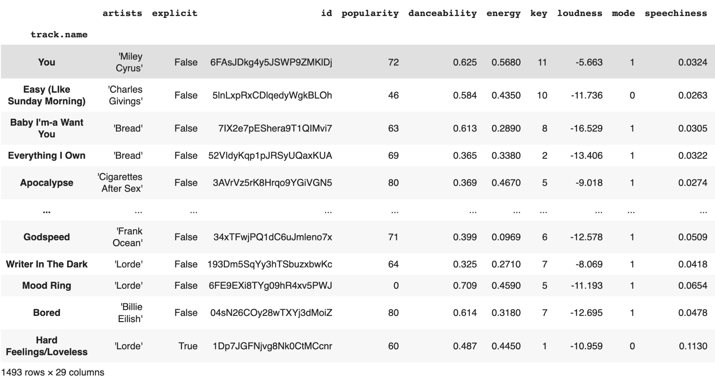
Notes:
The first few columns
1493 total songs
Each has 29 associated variables

Slide 8
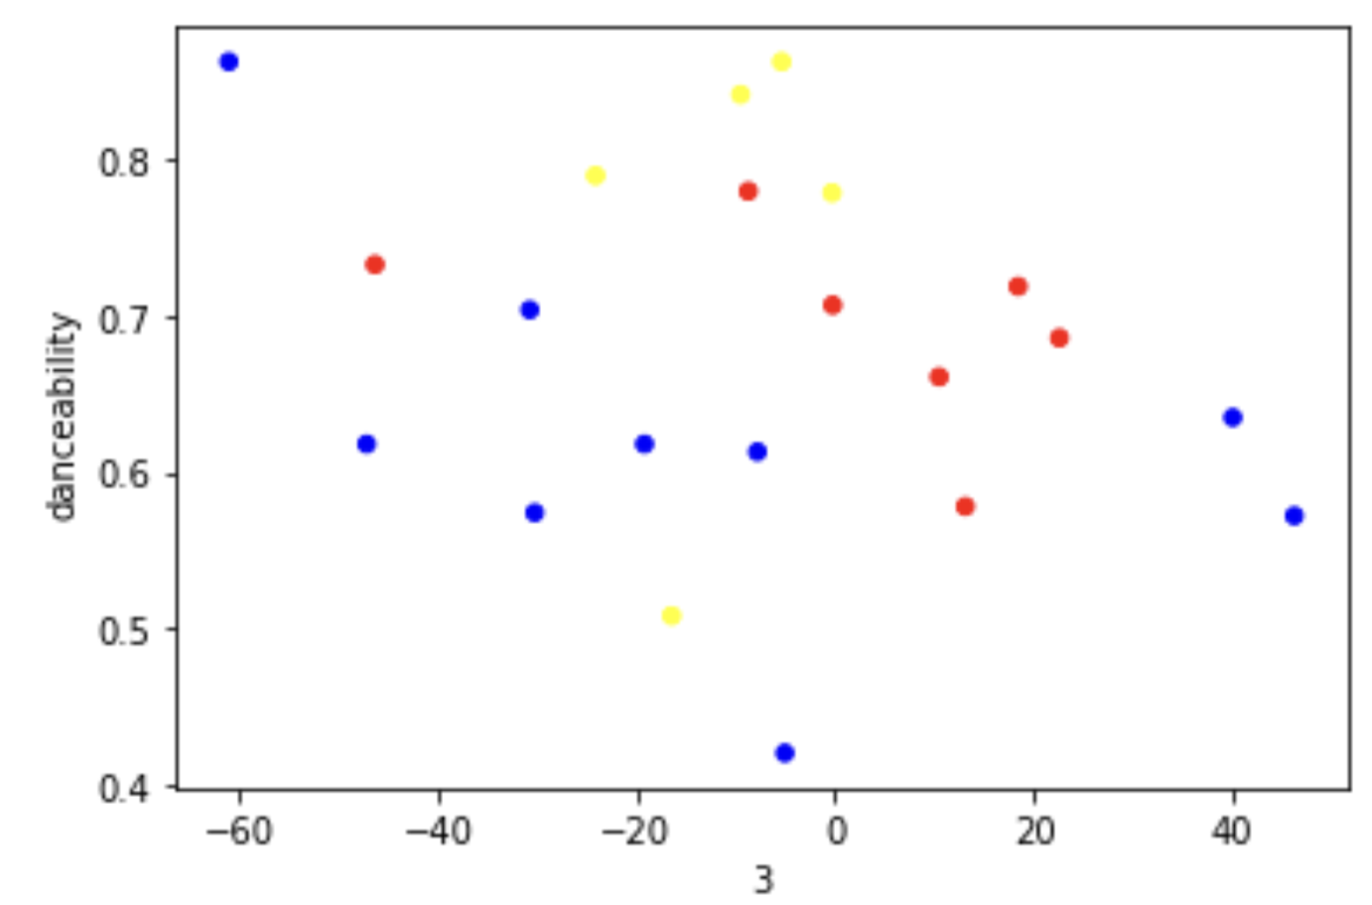
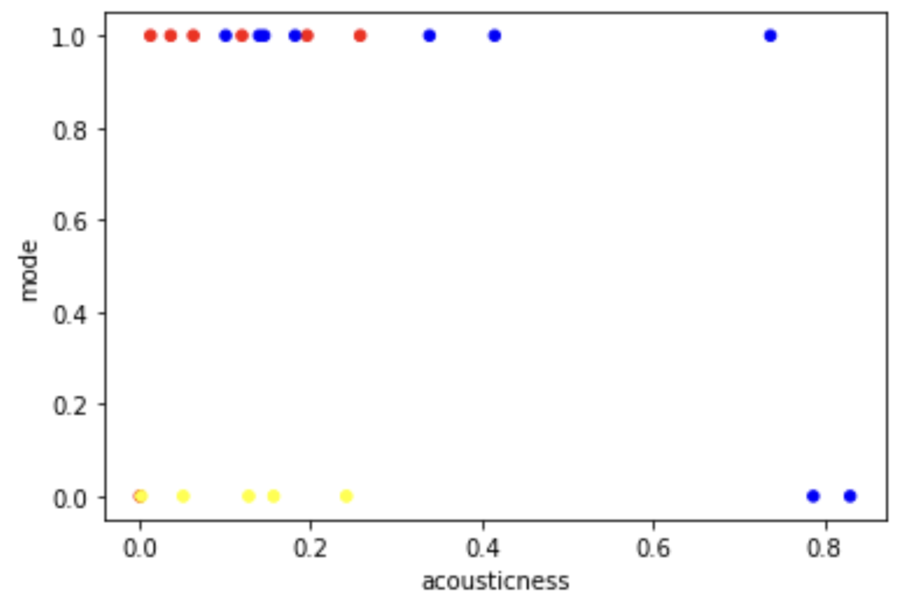
The Genre Issue
Notes:
Yellow = rap
Blue = r and b
Red = pop
Now that that’s settled, let’s investigate some relationships between vars

Slide 9
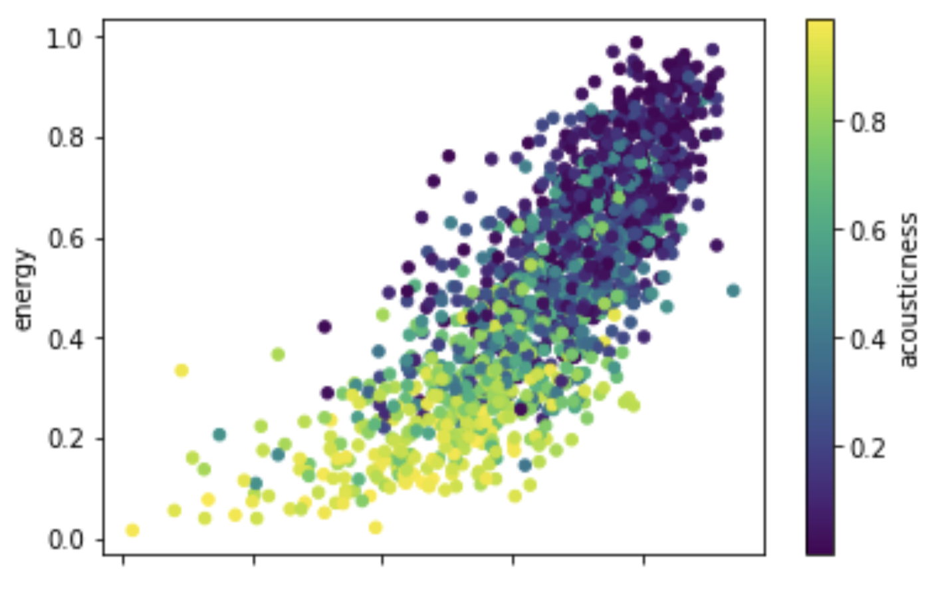
Exploring Relationships
loudness
Notes:
This shows that energy and loudness are strongly positively correlated (looks like pos slope line)
Also that acousticness is neg w both
Bc moving up or right darkens color (which corresponds to lower acousticness)

Slide 10
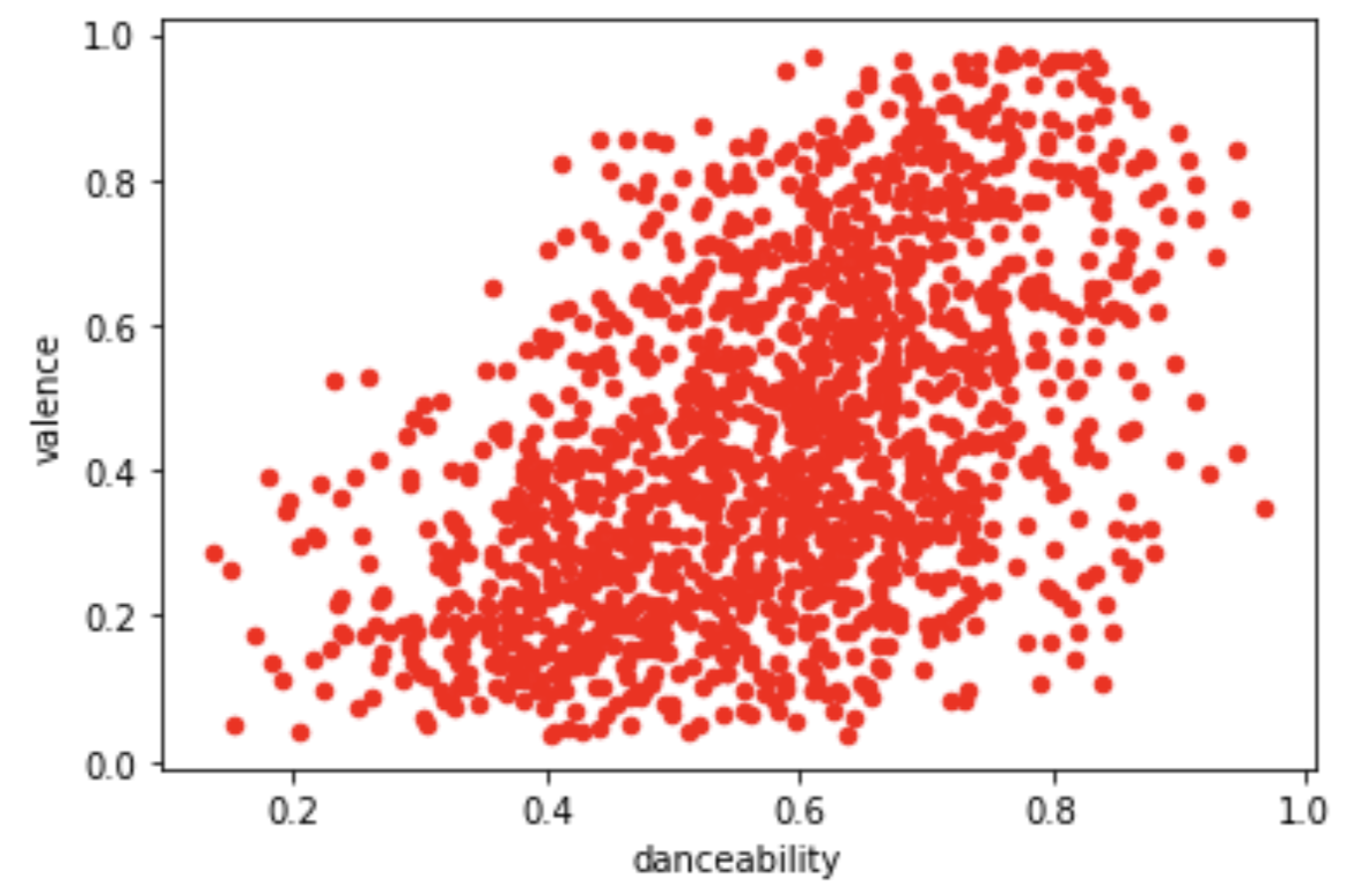
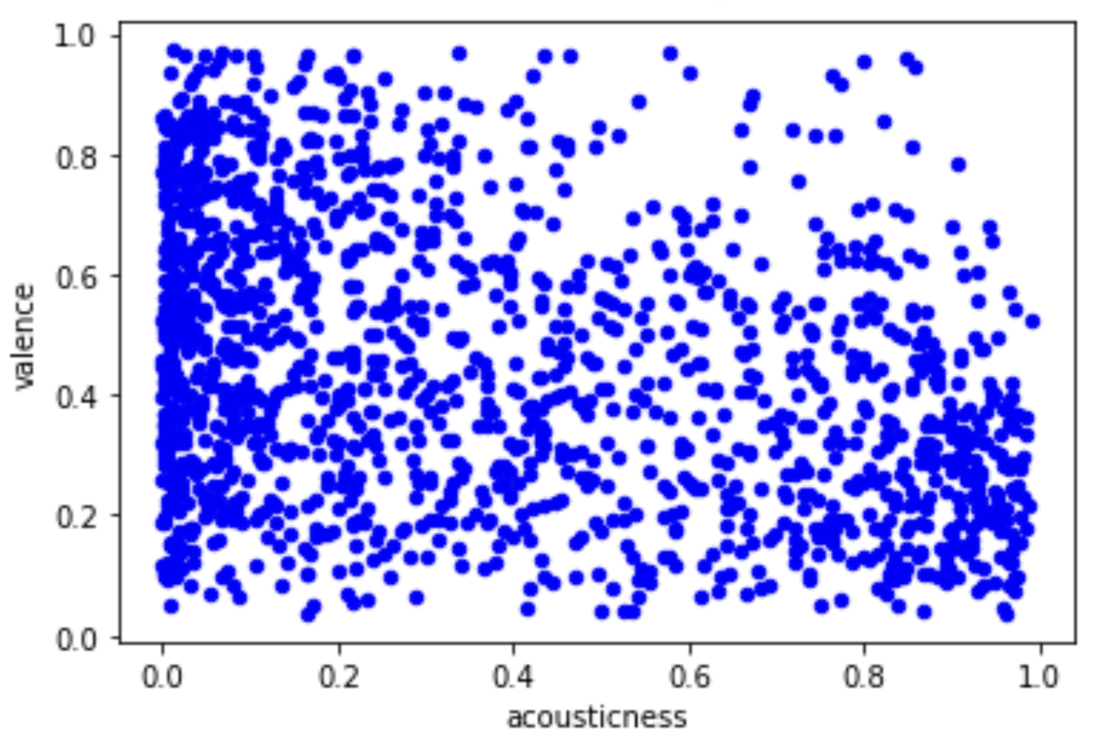
Exploring Relationships – valence
Notes:
I was really interested by valence var bc quantifies the mood of a song
On left, valence and danceability relatively positively correlated — unsurprising
On right, valence and acousticness rel neg corr (-0.4) — interesting bc it matches my expectation that lots of acoustic songs are sad (at least ones i listen to)

Slide 11
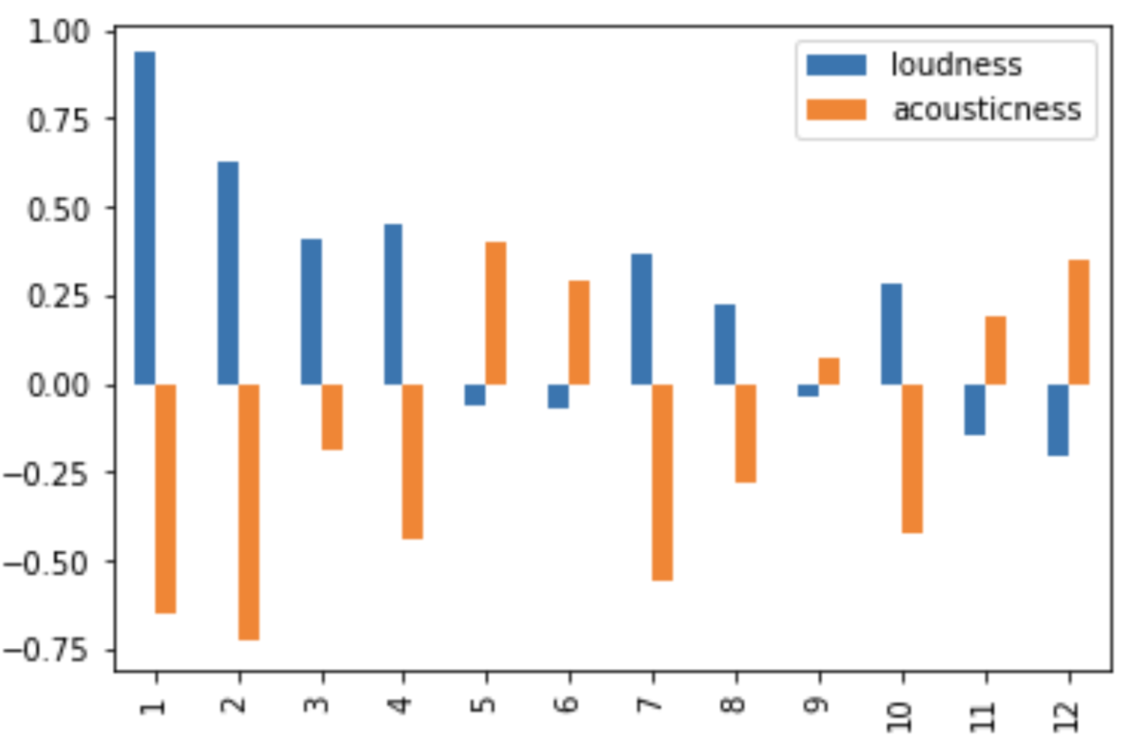
Making Sense of Timbre
Notes:
i wanted to make more sense of that
Here i plotted each index of the timbre vector’s correlations with loudness + acousticness
Loud + acoust have corr -0.65, so they are quite opp
You can see that opp reflected in every element in timbre
Often in the magnitude in addition to sign
This inspired me to try a model in which timbre was the only train data
That’s sneaking a head a bit to

Slide 12
Machine Learning
Notes:
Specifically a clustering model that organizes these observations into playlists

Slide 13
Background
“Playlist” — cluster of 10+ songs
Metric for evaluating:
for each playlist…
find standard deviation of each column
find sum of those
average those sums
*for comparison, all of the songs together score 61,248
Notes:
Before I get into it i have to define a few terms
First, i will be define a playlist as a cluster of 10+ songs
Second, i came up w a metric for evaluating my playlists
Statistical efficacy … but i used it in addition to my subjective taste
For comp to future numbers, all of the songs together score about a 61,000 (lower=better)

Slide 14
Variable Selection
Tried the following six combinations of training data
Everything, Min-Max Scaled
[All of the following are standard scaled]
Everything
Everything except popularity
Everything except timbre vector
Only timbre vector
Only “vibe” variables (i.e. danceability, acousticness)
Notes:
First, the question of preprocessing — I tried six different combinations of training data
I tried min-max scaling, standard scaling
i tried all of the data
Leaving a few select things out,
Trying only the timbre like i mentioned earlier
Trying only those subjective feeling ones
Decided on using all data w quants standard scaled

Slide 15
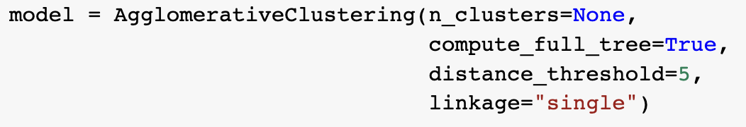
Hierarchical Clustering
Because not that different → one big cluster
SO, distance threshold
Hyperparameter tuning → 5
Priority: likeness of least similar songs → complete linkage
“Tommy score”: 35,092
Notes:
I first attempted hierarchical clustering
I noticed
There would be one HUGE playlist with practically all song
Except 19 others w only one song each
So, i decided to use a dist threshold
This type of hierarch clustering merges all clusters w/in that dist
It will make however many clusters necessary to cluster all observations
Still dissatisfied by my model pairing together wildly diff songs
So my priority was to make even the least alike songs w/in a cluster similar
-> so i used complete linkage

Slide 16
KMeans Clustering
n_clusters tuning: as n increases …
Number of playlists increases
Size of playlists decreases
Similarity increases
Tommy metric decreases
Decided on n_clusters=50 → score: 49524.1210558825
Notes:
Eventually though, i did use a tried and true kmeans model
In deciding the number of clusters, i noticed
Number of playlists inc
Size dec
But the similarity w/in increased (tommy metric decrease
Although this scored lower on tommy metric, i chose this

Slide 17
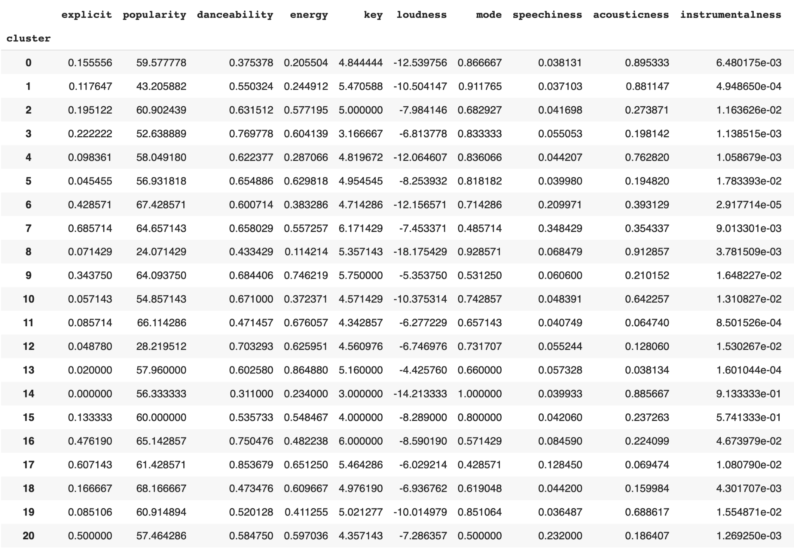
Analyzing Produced Playlists
variable means
Notes:
I started my analysis by finding the mean of each var within each playlist
This way i could compare them

Slide 18
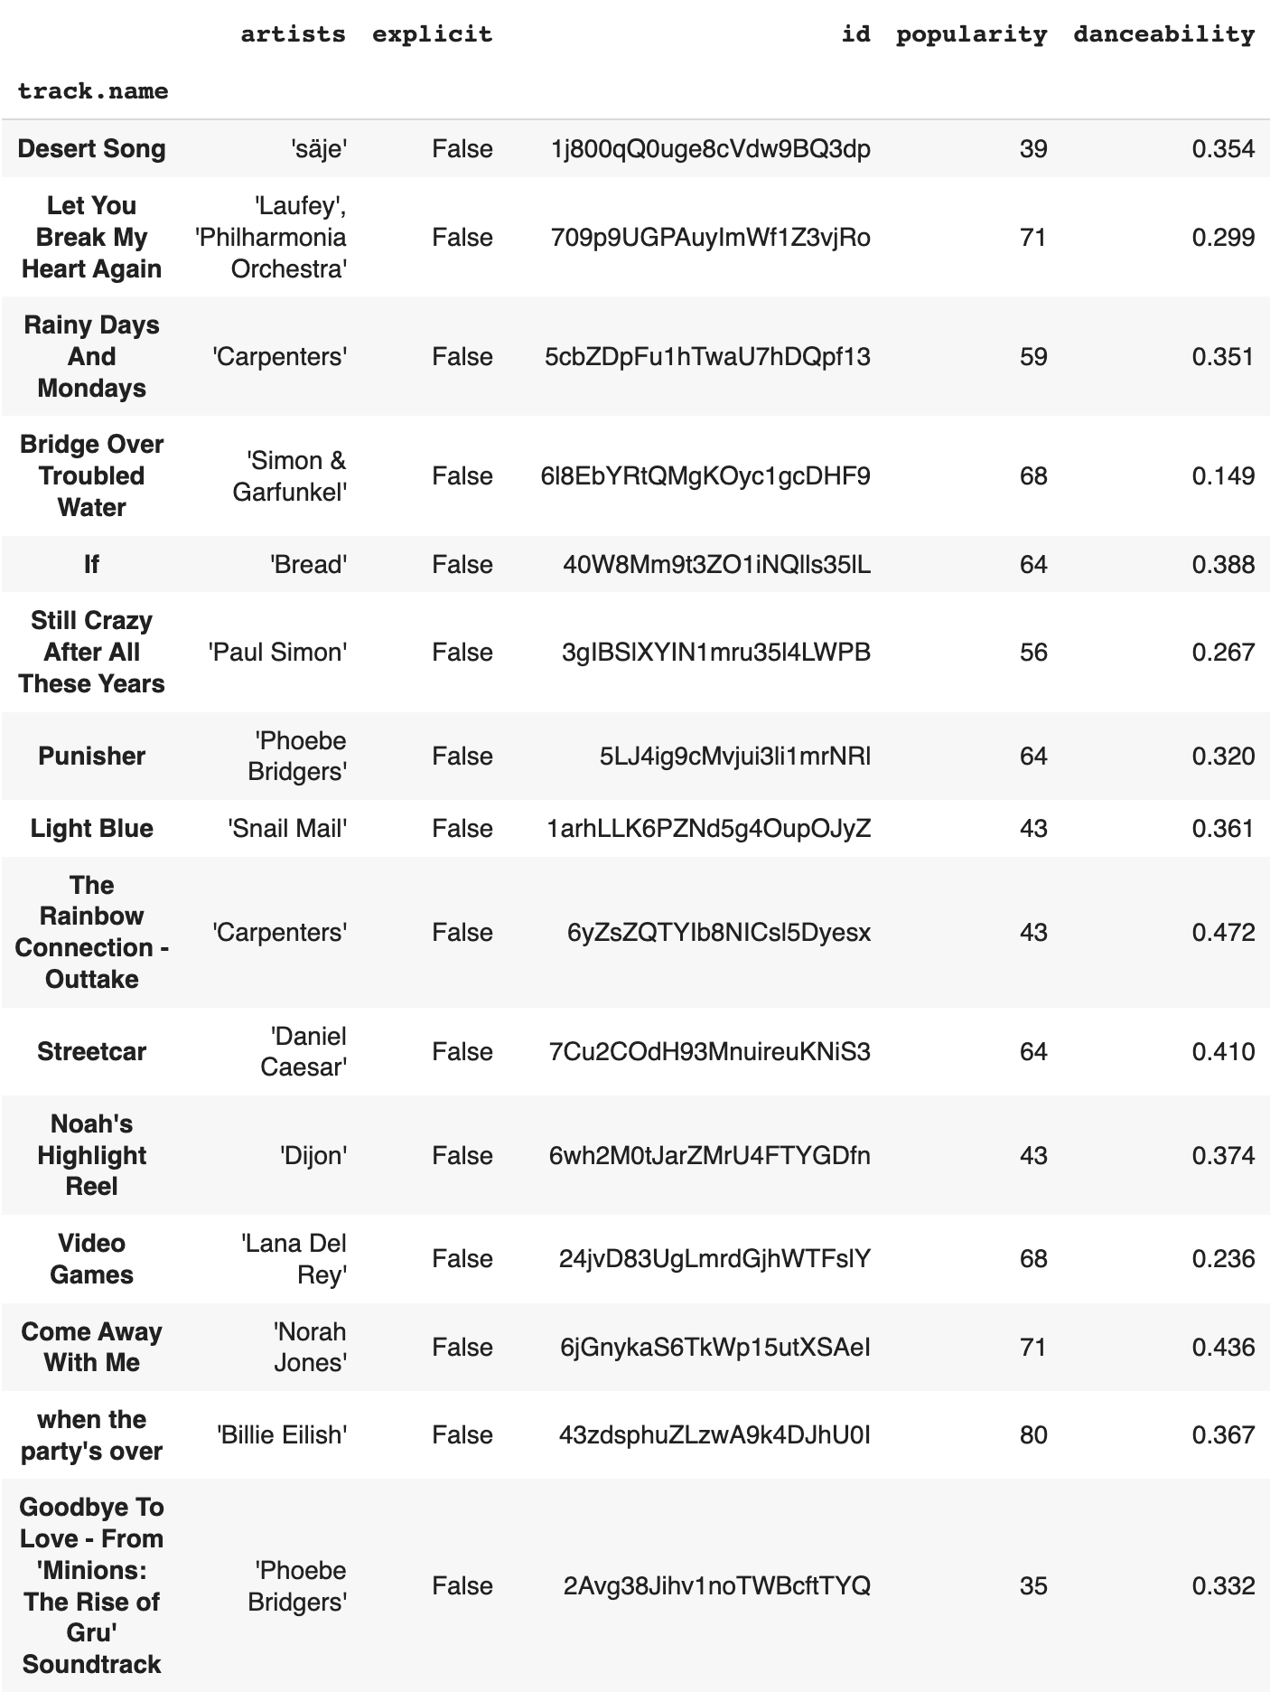
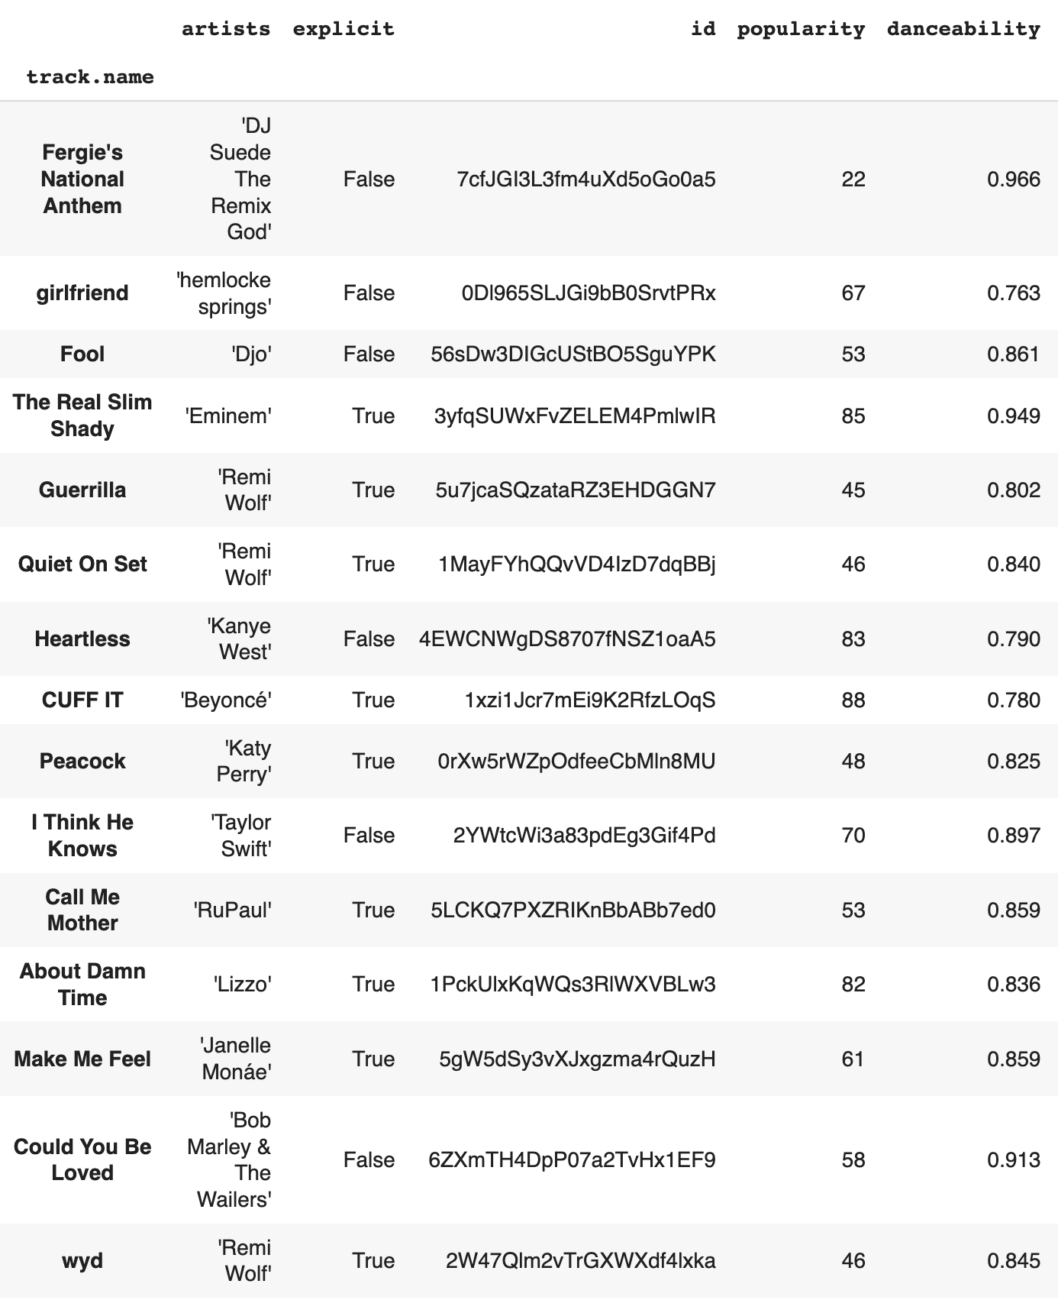
A Tale of Two Playlists
Notes:
From this i found one, for example, that was particularly danceable
This is on the left
Or the one on the right which was very acoustic

Slide 19
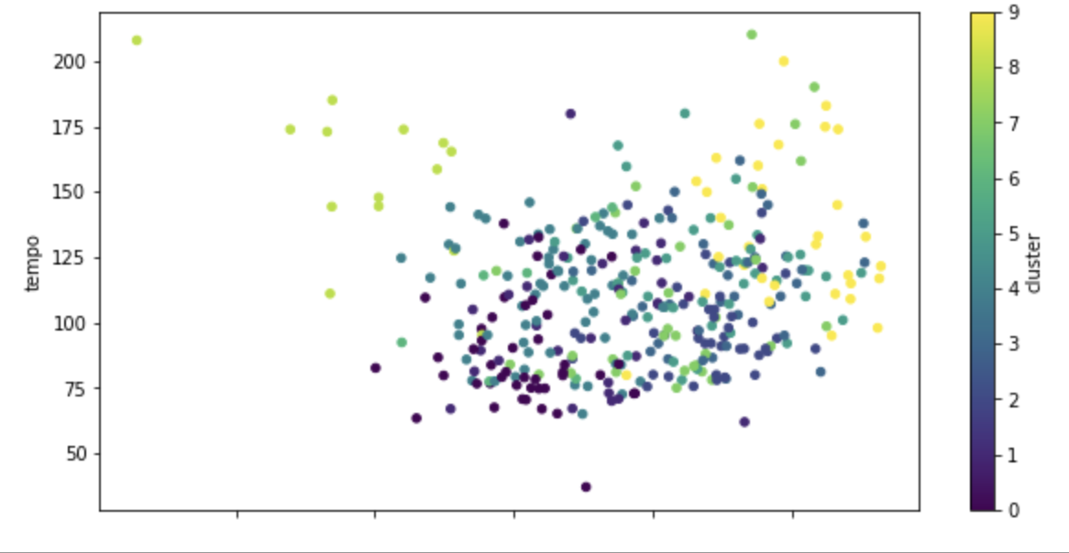
Visualizing The “Clusters”
“1”
Notes:
Finally, to demonstrate that my model is really “clustering” is doing as it says
I plotted the clusters in 2d space for various vars

Slide 20
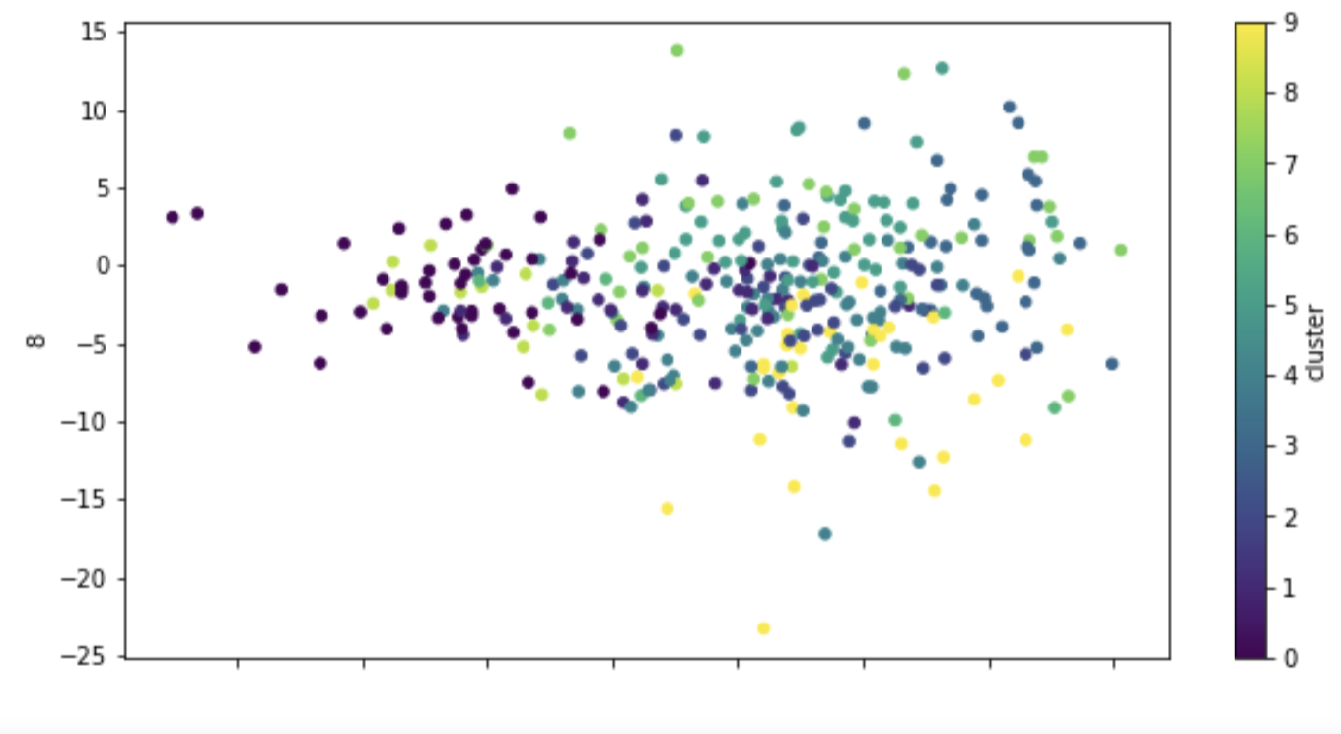
Visualizing The “Clusters”
danceability

Slide 21
Thank you!

